Slide 1
The Smart Ambulance Services
Batch Number: CSE-G 147
Roll Number | Student Name
20201CSE0778 | ANAS AHMED
20211LCS0016 20201CSE0776 20201CSE0724 | Mahammadanis M Sab Rayavarapu Sravan Ganesh
Under the Supervision of,
Mr. Prasad P.S
Assistant Professor
School of Computer Science & Engineering
Presidency University - Bangalore

Slide 2
Abstract:
Enhancing Emergency Medical Response:
Smart ambulance services are a revolutionary approach to improving emergency medical response.
Traffic Management Integration:
Integration with traffic management systems helps ambulances navigate through congested areas more efficiently.
Reduced Human Errors:
Automation and technology reduce the risk of human errors in the ambulance service.
Cost Savings:
Improved efficiency can lead to cost savings in the healthcare system.
Real-Time Location Tracking:
Smart ambulances are equipped with GPS systems for real-time tracking and precise location identification.
Faster Response Times:
The use of technology allows for quicker dispatch and route optimization, reducing response times.

Slide 3
Literature Survey :
Paper Name: Towards Vehicular Sensor Networks with Android Smartphones for Road Surface Monitoring.
Authors: Girts Strazdins, Artis Mednis, Georgijs Kanonirs, Reinholds Zviedris and Leo Selav
Description: Android is one of the most popular smartphone platforms at the moment, and the popularity is even rising. Additionally, it is one of the most open and flexible platforms providing software developers easy access to phone hardware and rich software API. We envision Android-based smartphones as a powerful and widely used participatory sensing platform in near future. In this paper we examine Android smartphones in the context of road surface quality monitoring. We evaluated a set of pothole detection algorithms on Android phones with a sensing application while driving a car in urban environment.

Slide 4
Paper Name: Accident identification system with SMS notification
Authors: Supriya vidhate, mamta tadavi, manisha jagtap, rajratan janrao
Description: In today’s world highway accident have become a common occurrence. Many people die each year due improper medical care after the accident happen. There is no effective method by which the correct authorities can be informed in time so that the person’s life can be saved. We are designing such a device which will not only detect any accident that happens to the car but also inform the appropriate authorities immediately as soon as the accident occurs

Slide 5
Paper Name: Applying QR Code and Mobile Application to Improve Service Process in Thai Hospital
Authors: Chayakrit Charoensiriwath, Navaporn Surasvadi, Suporn Pongnumkul, Thunyasit Pholprasit
Description: Hospital overcrowding has been a problem in Thai public healthcare system. The main cause of this problem is the limited available resources, including a limited number of doctors, nurses, and limited capacity and availability of medical devices. There have been attempts to alleviate the problem through various strategies.

Slide 6
Paper Name: Cloud Computing and Accident Handling Systems
Authors: Jabar H Yousif, Dinesh Kumar Saini
Description: An attempt is made to study the current issues of the cloud computing solutions for the life critical system- car accident systems in the Gulf region. Gulf region has high death rate because of car accidents and there is little or no proper accident handling facilities in the region.

Slide 7
Paper Name: Assessment of medication adherence app features, functionality, and health literacy level and the creation of a searchable Web-based adherence app resource for health care professionals and patients.
Authors: Seth Heldenbrand*, Bradley C. Martin, Paul O. Gubbins, Kristie Hadden, Catherine Renna, Rebecca Shilling, Lindsey Dayer
Description: Objectives: To assess the features and level of health literacy (HL) of available medication adherence apps and to create a searchable website to assist health care providers (HCP) and patients identify quality adherence apps. Practice description: Medication nonadherence continues to be a significant problem and leads to poor health outcomes and avoidable health care expense.

Slide 8
Paper Name: Providing Accident Detection in Vehicular Networks Through OBD-II Devices and Android-based Smartphones.
Authors: Jorge Zaldivar, Carlos T. Calafate, Juan Carlos Cano, Pietro Manzoni
Description: By combining smartphones with existing vehicles through an appropriate interface we are able to move closer to the smart vehicle paradigm, offering the user new functionalities and services when driving. In this paper we propose an Android based application that monitors the vehicle through an On Board Diagnostics (OBD-II) interface, being able to detect accidents.

Slide 9
Paper Name:GPS based tracking and health parameter detection.
Authors: Shivali Walvekar and Kinjal More
Description: It displays the current location of ambulances and patient’s health parameter on the LCD display and sends that information to the hospital

Slide 10
Paper Name:Intelligent accident detection and RF communication.
Authors: Bhandari Prachi, Dalvi Kasturi and Chopade Priyanka
Description:It’s a web based application that shows the nearest ambulances, clinic and pharmacies to the user. The sensors placed in the vehicles helps in automatic accident detection and inform it the ambulance.

Slide 11
Objectives:
Improve ambulance service response times.
Optimize resource allocation for faster dispatch.
Enhance user satisfaction and accessibility.
It is a user-friendly mobile applications.
Establish a cost-effective and efficient model

Slide 12
Existing Methods & Drawbacks:
Traffic Monitoring Through GPS:
The GPS system of these smart ambulance is upgraded enough to fetch the real-time data from the traffic management authorities.
RFID Technology:
Besides this, these ambulances are utilizing the RFID technology for automated updates regarding inventory and medical consumables.
IOT:
The Internet of Things, or IoT, is a network of physical devices. These devices can transfer data to one another without human intervention. IoT devices are not limited to computers or machinery
Drawback:
There are some challenges awaited after the practical implementation of this idea of smart ambulances. The foremost is the security of the data, including patients’ profile, shared between the doctor and the patients.

Slide 13
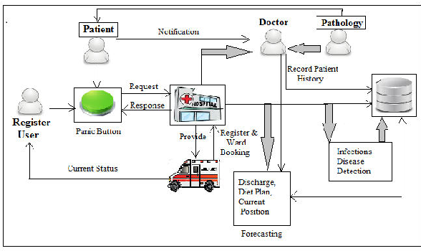
Architecture:

Slide 14
Methodology
Project Initiation:
Define the project scope, objectives, and goals.
Establish a project team and leadership.
System Design and Architecture:
Define the architecture of the smart ambulance system, including hardware, software, and communication components.
Technology Selection and Procurement:
Choose and procure the necessary technology components, such as IoT sensors, GPS devices, telemedicine equipment, and communication systems.
Software Development:
Develop software for dispatch, routing optimization, patient monitoring, and communication.
User Interface Design:
Design user-friendly interfaces for the mobile app and ambulance equipment.
Real-time data analysis:
Predictive modeling will drive efficient ambulance dispatch, resource allocation, and routing. Rigorous testing and feedback loops will refine the system.

Slide 15
Timeline of Project
Project Initiation (Month 1-2)
Define project goals and objectives.
Identify key stakeholders and form a project team.
Secure funding and resources.
Market Research and Analysis (Month 3-4)
Conduct market research to understand the current ambulance service landscape.
Identify competitors and potential partners.
Determine target regions and demographics.
Concept and Requirements (Month 5-6)
Develop a concept for the smart ambulance service.
Define the technical and functional requirements.
Create a preliminary budget and project plan.
Technology Selection and Procurement (Month 7-8)
Choose the necessary hardware and software components.
Procure or develop the technology required for the service.
System Design and Development (Month 9-12)
Develop the smart ambulance service infrastructure.
Create a mobile app or web portal for users.
Integrate real-time tracking, communication, and data analysis features.
Perform initial testing and quality assurance.

Slide 16
Conclusion
In conclusion, this project seeks to enhance ambulance booking services by addressing existing shortcomings and introducing innovative solutions. By reducing response times, minimizing errors, and improving the user experience, we aim to create a more efficient and effective system. Our work has the potential to significantly impact emergency healthcare and public safety.

Slide 17
References
https://www.tutorialspoint.com/index.htm
https://ieeexplore.ieee.org/document/9609423/
https://nevonprojects.com/emergency-ambulance-booking-android-app/
[1] C. Perera, C. H. Liu, and S. Jayawardena, “The Emerging Internet of Things Marketplace From an Industrial Perspective: A Survey,” IEEE Trans. Emerg. Topics Comput., vol. 3, no. 4, pp. 585–598, 2015.
[2] S. Verma, Y. Kawamoto, Z. M. Fadlullah, H. Nishiyama, and N. Kato, “A Survey on Network Methodologies for Real-Time Analytics of Massive IoT Data and Open Research Issues,” IEEE Commun. Surveys Tut., vol. 19, no. 3, pp. 1457–1477, 2017.
[3] J. Jin, J. Gubbi, T. Luo, and M. Palaniswami, “Network Architecture and QoS issues in the Internet of Things for a Smart City,” in Proc. Int. Symp. Communications and Information Technologies, 2012, pp. 956–961.

Slide 18
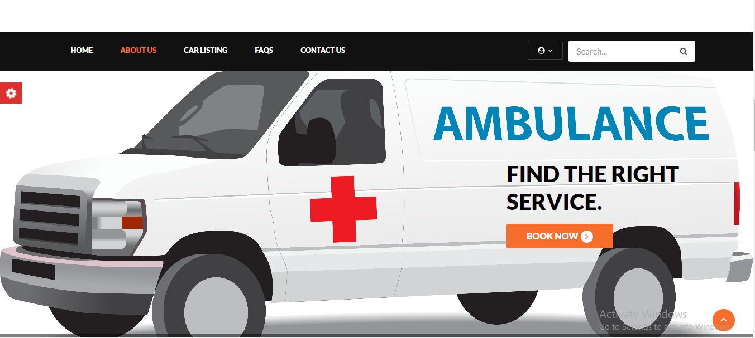
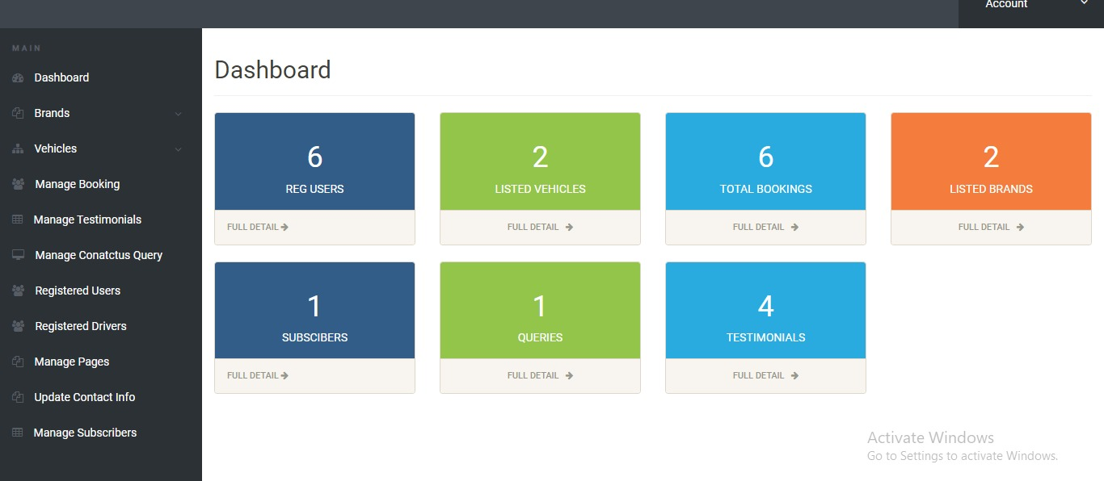
Screenshots

Slide 19
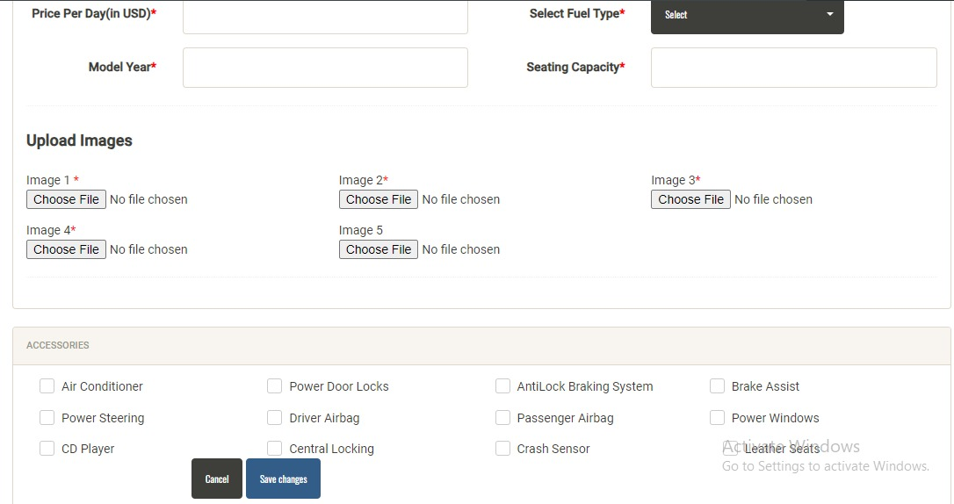

Slide 20

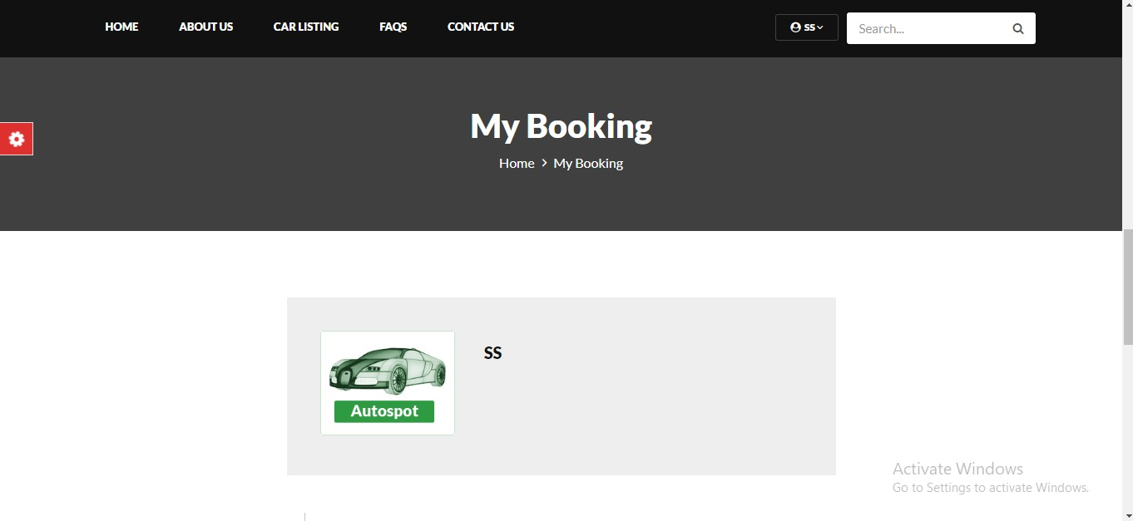

Slide 21
THANK YOU

